Slide 1
Faculty Research Database
Lowell Pence, Campbell Schweickhardt, Vincent Cheng

Slide 2
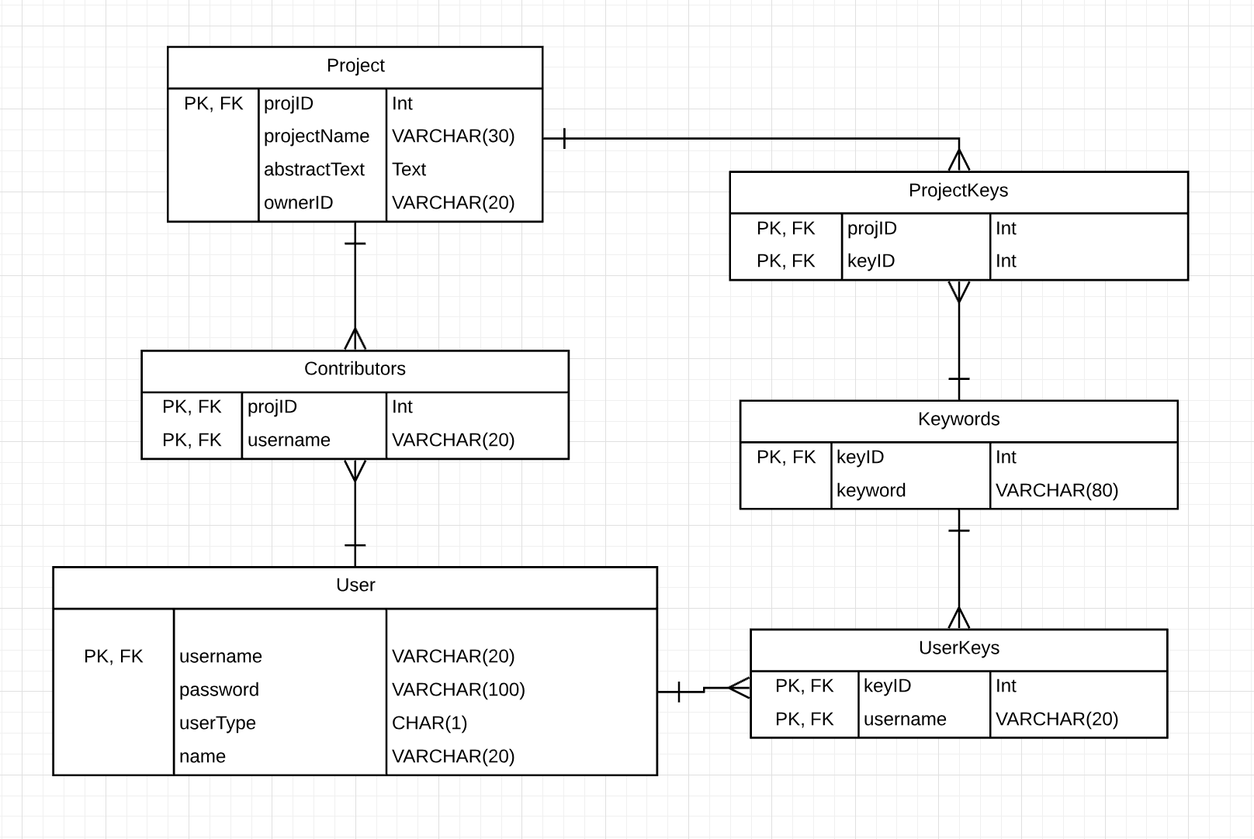
Key Data Layer Features
3 important tables (Users, Projects, and Keywords)

Slide 3
Project
Our data layer includes functionality so that every aspect of a project can be edited, retrieved, created, and deleted where appropriate.
Only faculty can create projects and edit/delete their own projects.
Anyone can query the database for projects by name, keyword, owner, or contributor.

Slide 4
User
There are student and faculty users.
Admin users have a unique functionality to create and alter user info (similar to RIT accounts)
You may find a user by looking up a project they may be associated with, a keyword they may be associated with, or their name/ username/ user type.

Slide 5
Keywords
There are many keywords created by faculty when they create a new project.
Each faculty and student user account can have any number of associated keywords.

